Slide 1
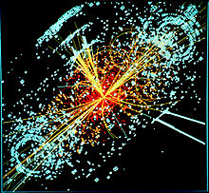
Cathode Ray Oscilloscope(CRO)
Dated: 19 July 2020
Vinod Singh
Department of Physics
VSKC Govt. Post Graduate College
Dakpathar, Dehradun
Uttarakhand Open University Hadwani (UK)

Slide 2
Outline:
Introduction
CRO and its uses
To Measure AC voltage and calculate its Deflection Sensitivity.
To Measure DC using CRO.
To determine vertical and Horizontal sensitivities of CRO.
Calibration of a CRO.
To determine unknown frequency using CRO

Slide 3
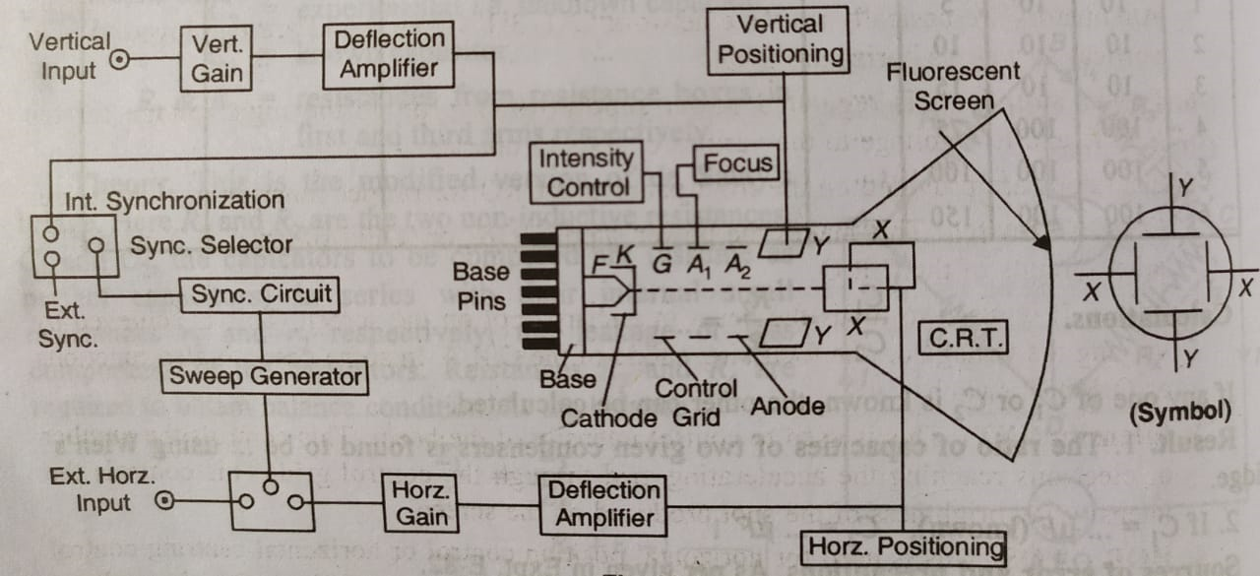
Cathode Ray Oscilloscope(CRO)
CRO gives a two dimensional display of voltage applied to its vertical (Y-Y) and time axis along horizontal (X-X) input terminals.
Construction
of CRO
CRO Tube
Time base Generator
Synchronization
Amplifiers
Attenuators
Power Supply

Slide 4
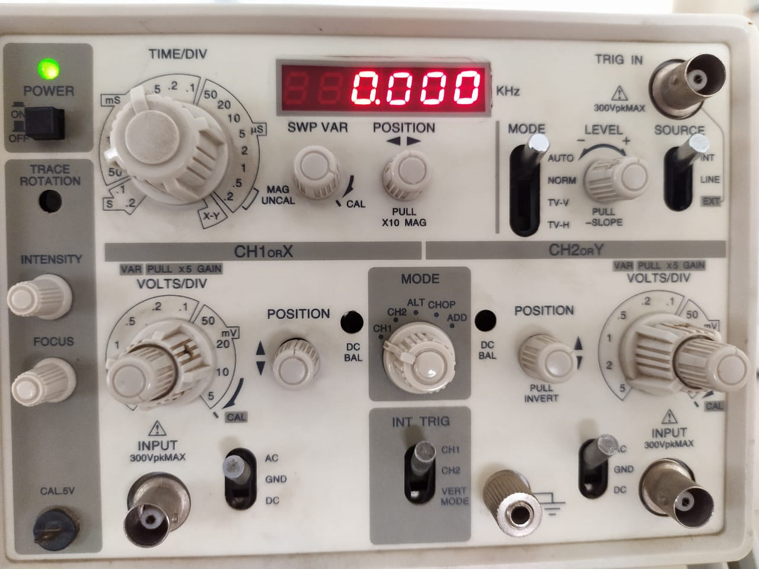
Knobs of CRO
ON/OFF Switch
Focus
Intensity(INT)
Horizontal-Position
Vertical Position
HOR-GAIN
VER-GAIN
Synchronization
Time/ Base
HOR-Input
VER-Input
AC-0-DC Selector
Frequency Selector and Frequency Vernier

Slide 5
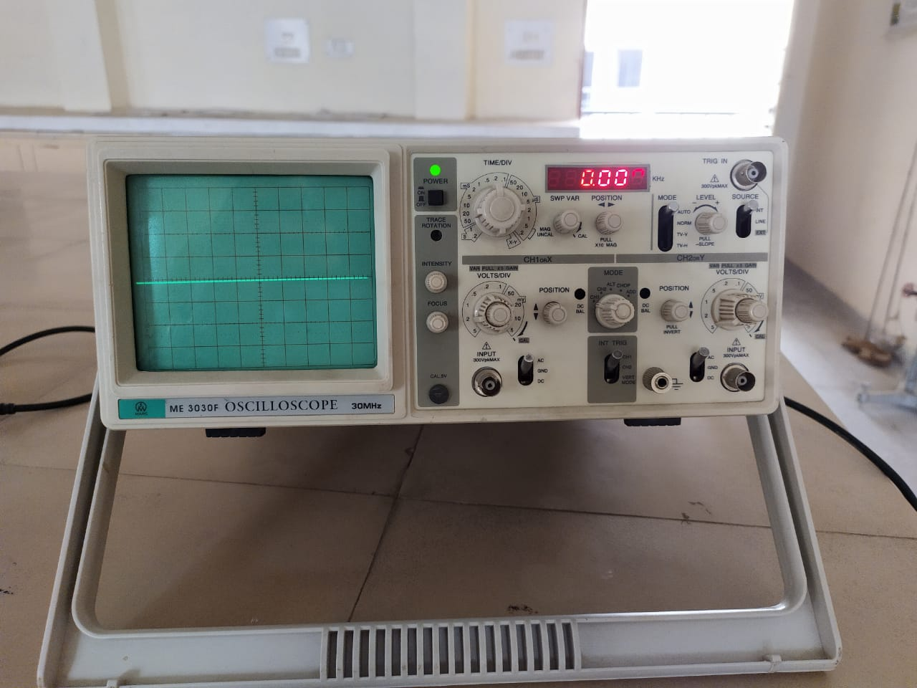
Cathode Ray Oscilloscope(CRO)

Slide 6
USES of CRO:
The CRO is an instrument in physics laboratory to study DC as well as AC electric voltage variations in its magnitude and direction.
Visualize the exact nature of waveform of an AC for Amplifiers and Oscillators.
To find the unknown frequency of AC voltage and phase difference between voltage and current in inductive elements L, C and their combination along with R.
Experiments:
To Measure AC voltage and calculate its Deflection Sensitivity.
To Measure DC using CRO.
To determine vertical and Horizontal sensitivities of CRO.
Calibration of a CRO.
To determine unknown frequency using CRO.
Details of Experiments on CRO will discussed in workshop

Slide 7
Thank You

