Slide 1
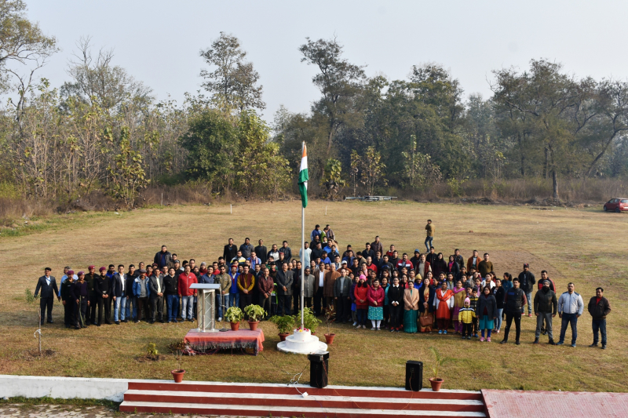
Directorate of Research and Innovation
PRESENTATION
FOR
THE NAAC PEER TEAM (13-Sept.-2022)
Information about the Ph.D Degree (For UGC) (15-Oct-2024)

Slide 2
Establishment of Directorate of Research and Innovation
The Directorate of Research and Innovation was established in the year 2012 after complying with all the statutory provisions and other guidelines as issued by UGC.
https://uou.ac.in/downloads/directorate-establishment.pdf

Slide 3
About the Directorate of Research and Innovation
The Directorate of Research and Innovation is continuously striving for streamlining the process of research work, exploring key research areas and designing strategies for the accomplishment of research goals.
The flagship programme of the Directorate is Ph.D. Programme which is offered in Twenty Five Disciplines of study at present.
The thrust Area to be researched by the Directorate has been identify on the basis of three broad areas :
Local Aspirations
Open and Distance Learning and
Discipline Specific Areas.

Slide 4
Cont…
The Directorate also intends to support collaborative Projects between Researchers, University’s Faculty, Officers and Learners who seek to innovate, in partnership with National and International Organizations.

Slide 5
MOUs in Research
Name of University/Institution | Subject
Uttarakhand Science Education & Research Center | Promotion of Science Education and Technology among the learning community
Odisha Open University | Development of academic and cultural interchange the areas of research and other activities
Pandit Sunderlal Sharma Open University Bilaspur Chhattisgarh | Joint Research Activities including interdisciplinary Research and Research project
Uttarakhand Ayurved University Dehradun | Encourage between the scientists, research fellows, research scholars, faculty members and students both the universities
https://uou.ac.in/uouphd (In MOUs Section)
Notes:
Add hyperlink

Slide 6
Grants for Research Projects
Year | Number of Teacher | Name of Teacher | Fund Receive (In Lakh) | Agency | Documentlink
2014-15 | 02 | Dr. Manjari Agarwal Dr. Deepak Paliwal | 225000.00 290000.00 | UGC NIOS (MHRD) | Documents\2014-15
2015-16 | 01 | Dr. Deepak Paliwal | 800000.00 | UGC | Documents\2015-16
2016-17 | 01 | Dr.Jeetendra Pande | 750000.00 100000.00 | Common wealth of learning, CEMCA Uttarakhand Science Education and Research Center, Dehradun | Documents\2017-18
2017-18 | 02 | Prof. Girija Pande Dr. Jeetendra Pande | 1000000.00 | RUSA | Documents\2016-17
2018-19 | 2 | Dr. Jeetendra Pande Dr. H.S Bisht | 1350000.00 580000.00 | Ministry of Human Resource Development IGNOU ICSSR | Documents\2018-19
2019-20 | 01 | Dr. Jeetendra Pande | 645000.00 | Common wealth of learning, CEMCA | Documents\2019-20
2020-21 | 02 | Dr. Manjari Agarwal Mr. Bhupen Singh | 100000.00 25977.00 | Uttarakhand Science Education and Research Center, Dehradun Indian institute of mass communication | Documents\2020-21
2021-22 | 01 | Dr.Jeetendra Pande | 655000.00 | Common wealth of learning, CEMCA | Documents\2020-21

Slide 7
Structure of Directorate
Director
Assistant Director
Assistant Director
Administrative Consultant
Research Officer1
Research Officer3
Research Officer2

Slide 8
Objectives of the Directorate
To accomplish local and regional aspirations, fulfill national obligations and honor the international commitment through high-quality research in various disciplines.
To survey and assess the impact of Uttarakhand Open University on the status of higher education.
To assess the student support services of university and to suggest measures for efficient functioning.
To identify potential areas for newer programs which are more amenable to ODL.
To organize Open and Distance Learning related seminars and workshops,

Slide 9
Adherence to the UGC Regulations
University Grants Commission UGC (Minimum standard and Procedure for Awards of M.PHIL/PH.D. Degree), Regulation,2009
University Grants Commission UGC (Minimum standard and Procedure for Awards of M.PHIL/PH.D. Degree), Regulation,2016
University Grants Commission UGC (Minimum standard and Procedure for Awards of M.PHIL/PH.D.Degree)(1st amendment) Regulation,2018
University Grants Commission UGC (Minimum standard and Procedure for Awards of M.PHIL/PH.D. Degree)(2nd amendment) Regulation,2018
University Grants Commission UGC (Minimum standard and Procedure for Awards of M.PHIL/PH.D. Degree Regulation,2022

Slide 10
UOU Ph.D Ordinance
Ph.D Ordinance- 2011 (https://uou.ac.in/sites/default/files/2021-10/Ph.D.-Ordinance%20-2011.pdf)
Ph.D Ordinance- 2016 (https://uou.ac.in/sites/default/files/2021-10/Ph.D.-Ordinance-2016.pdf)
Ph.D Ordinance- 2016 with Amendment 2020 (https://uou.ac.in/downloads/dri/uou-phd-ordinance-21.pdf)
Ph.D Ordinance 2023(https://uou.ac.in/uploads/Ordinance-2023.pdf)
Notes:
@Ph.D. Ordinance – 2011
Ph.D. Ordinance - 2016
Ph.D. Ordnce 2016 with ammendment 2020

Slide 11
Research Council and Minutes
The Research Council Constituted as per guidelines of UGC Regulation “University Grants Commission UGC (Minimum standard and Procedure for Awards of M.PHIL/PH.D. Degree), Regulation,2016”
, Under UOU Notification No.- uou/research/782 Dated 04/02/2017.
First Research Council meeting held on dated 17-03-2017
https://uou.ac.in/downloads/dri/rcouncil/first%20research%20council%20meeting%20minutes.pdf
Second Research Council Meeting held on dated 15-10-2020
https://uou.ac.in/downloads/dri/rcouncil/second%20research%20council%20meeting%20minutes.pdf

Slide 12
Cont….
Third Research Council Meeting held on dated 29 April 2023.
https://uou.ac.in/downloads/dri/rcouncil/third%20research%20council%20meeting.pdf

Slide 13
Structure of Research Council
Vice Chancellor (Chairman)
Director of Research
(Member Secretary)
Two External Experts nominated by Vice Chancellor
(Members)
Each of one member of Planning board and academic Council nominated by Vice Chancellor
All Director of Schools
(members)

Slide 14
List of disciplines in which Ph.D. Programme is being offered
Disciplines
Disciplines
History
Physics
Chemistry
Yoga
Management Studies
Social Work
Commerce
Environmental Science
Computer Science
Jyotish
Journalism and Media studies
Public Administration
Home science
Education
English
Sanskrit
Hindi
Sociology
Political Science
Tourism & Hospitality
Mathematics
Botany
Zoology
Psychology
Economics

Slide 15
Entrance Test Procedure
Entrance Test
GENERAL PAPER ON RESEARCH APTITUDE
Document Verification
Checking of Documents as per the Eligibility Criteria
Concept Note Writing
Topics are given from the concerned Department.
Presentation of the Research proposal
Interview
Evaluated by the Director/ Programme Coordinator
Presentation in front of the Panel.
Submits Proposal both in Hard and Soft Copy.
Subject Specific
Allocation of Seats
Allocation of seats as per Merit.
Category Wise allocation
Comprehensive Sheet is prepared as per the Weightage of Concept Note ,Presentation and Interview

Slide 16
Ph.D admission procedure
Filling and Submitting the Application Form only Online mode
Conduct the Entrance Exam in Major Cities of Uttarakhand
Notification on University’s Website also Published on the National and Local Newspaper
Entrance Test

Slide 17
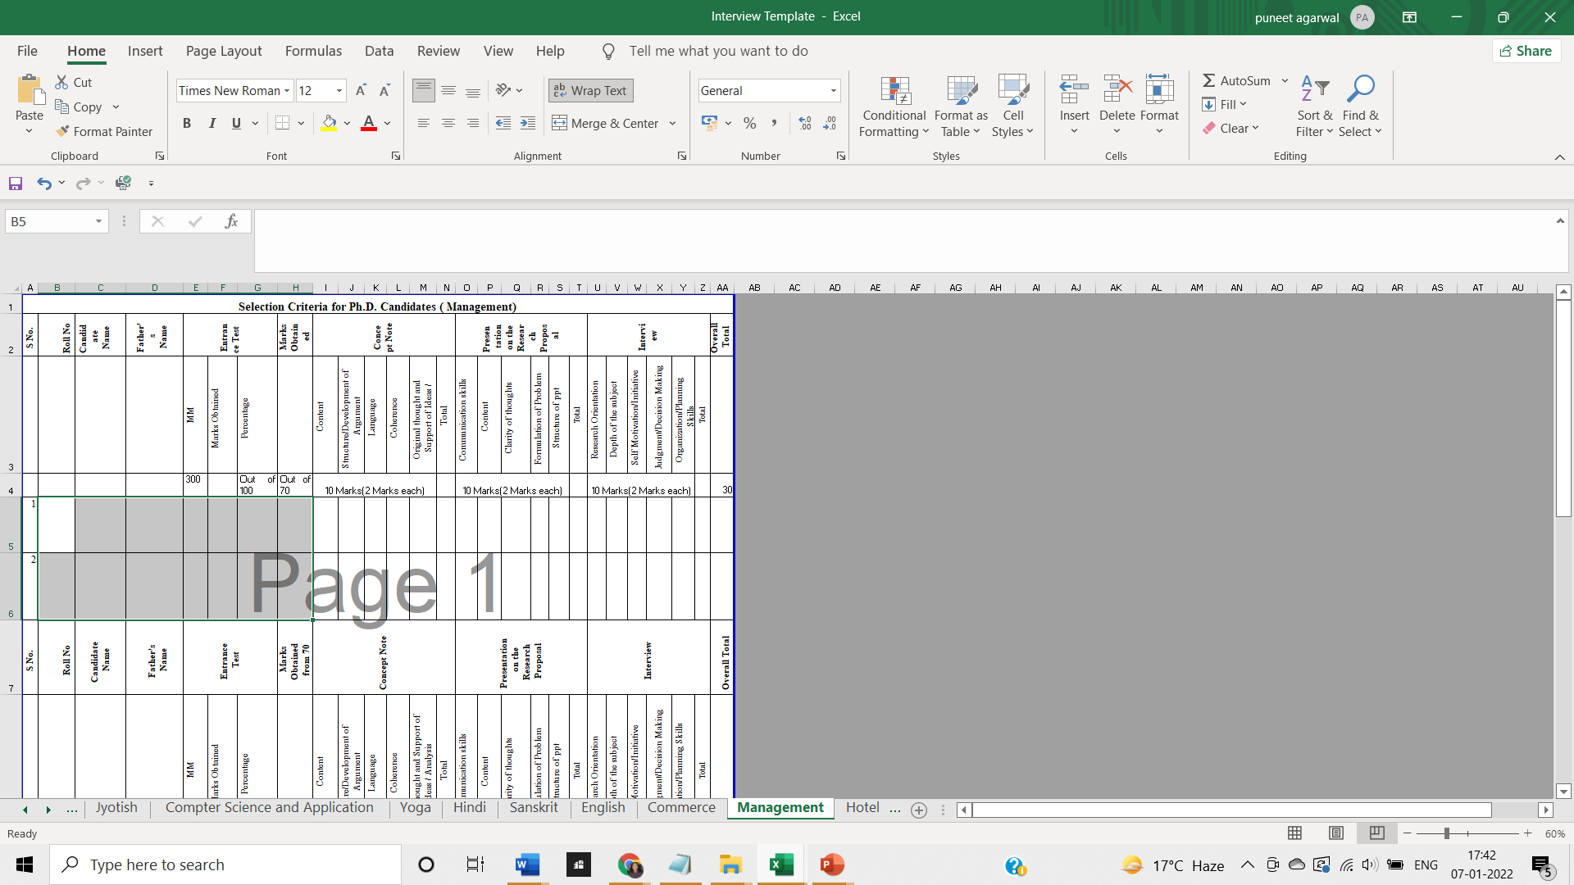
Comprehensive Sheet template for selection

Slide 18
Fee Structure
Year | Programme Fee | Registration/Course Work Fees/Examination Fee | Thesis Evaluation Fees | Identity Card | Student Welfare | Degree Fee | Total Fees
I | 6,500 | 6,500 | - | 50 | 100 | - | 13,150
II | 6,500 | - | - | - | - | - | 6,500
III | 6,500 | - | - | - | - | 500 | 7,000
IV | - | - | 10000 | - | - | - | 10,000
https://uou.ac.in/uouphd

Slide 19
Ph.D. Course Work Structure (One Semester: 06 Months)
2 Modules of 3 Credits each
2×3=06
05 Modules of 2 Credits each
5×2=10
Total Credits
16×30=480 Hours

Slide 20
Modules/Courses of Study
04
Discipline Specific Research Methodologies
03
Research Writing and Technological Inputs in Research
05
Emerging Trends and Major Thrust areas in Discipline Specific Research Approaches
02
Tools and techniques for data collection
06
Formulating a Research Proposal
01
Introduction of Research
07
Research and Publication Ethics (RPE)

Slide 21
Course Work Assessment
CW 01
Module I
CW 02
Module III
Module IV
Implemented by Directorate
CW03
Module V
Implemented by Concerned Department
CW04
Module VI
Implemented by Concerned Department
CW05
Research and Publication Ethics
Implemented by Directorate
Evaluation (Theory+ Assignment) – 80+20 Marks
Implemented by Directorate
Evaluation (Theory+ Assignment) – 80+20 Marks
Evaluation (Theory + Assignment) – 80+20 Marks
Evaluation (Theory+ Assignment) – 80+20 Marks
Evaluation project (Presentation + Viva) – 50 + 50 Marks
Module II
Evaluation (Theory+ Assignment) – 80+20 Marks
https://uou.ac.in/downloads/dri/coursework-curriculum-phd.pdf

Slide 22
Daily Lecture Report
https://uou.ac.in/downloads/dri/lecture-report
Attendance
Format of Progress Report
https://uou.ac.in/downloads/progress-report-format-22.pdf
Notes:
Daily Lecture Report

Slide 23
Innovative Practices In Coursework
Class Representative for Daily Session
Daily Lecture Report prepared by Day Monitors
Online Module on SPSS
Statistical Software Awareness
Online Classes since 2019
Promoting Blended Learning

Slide 24
Inclusion of MOOCS or Other Online Courses
The online course can be taken from reputed recognized sites (such as SWAYAM,
www.edx.org,
www.coursera.org,
www.nptel.ac.in,
www.aima.in,
www.britishcouncil.org,
MIT Open Courseware,
www.khanacademy .org
This may be considered broadly under University Grants Commission (Online Courses or Programmes) Regulations, 2018.

Slide 25
Experts from other Universities and Institutions
IGNOU
University of Delhi
Kumaon University
JNU
IIM, Kashipur
IIT , Roorkee
Université de Montréal
Govind Ballabh Pant University of Agriculture and Technology

Slide 26
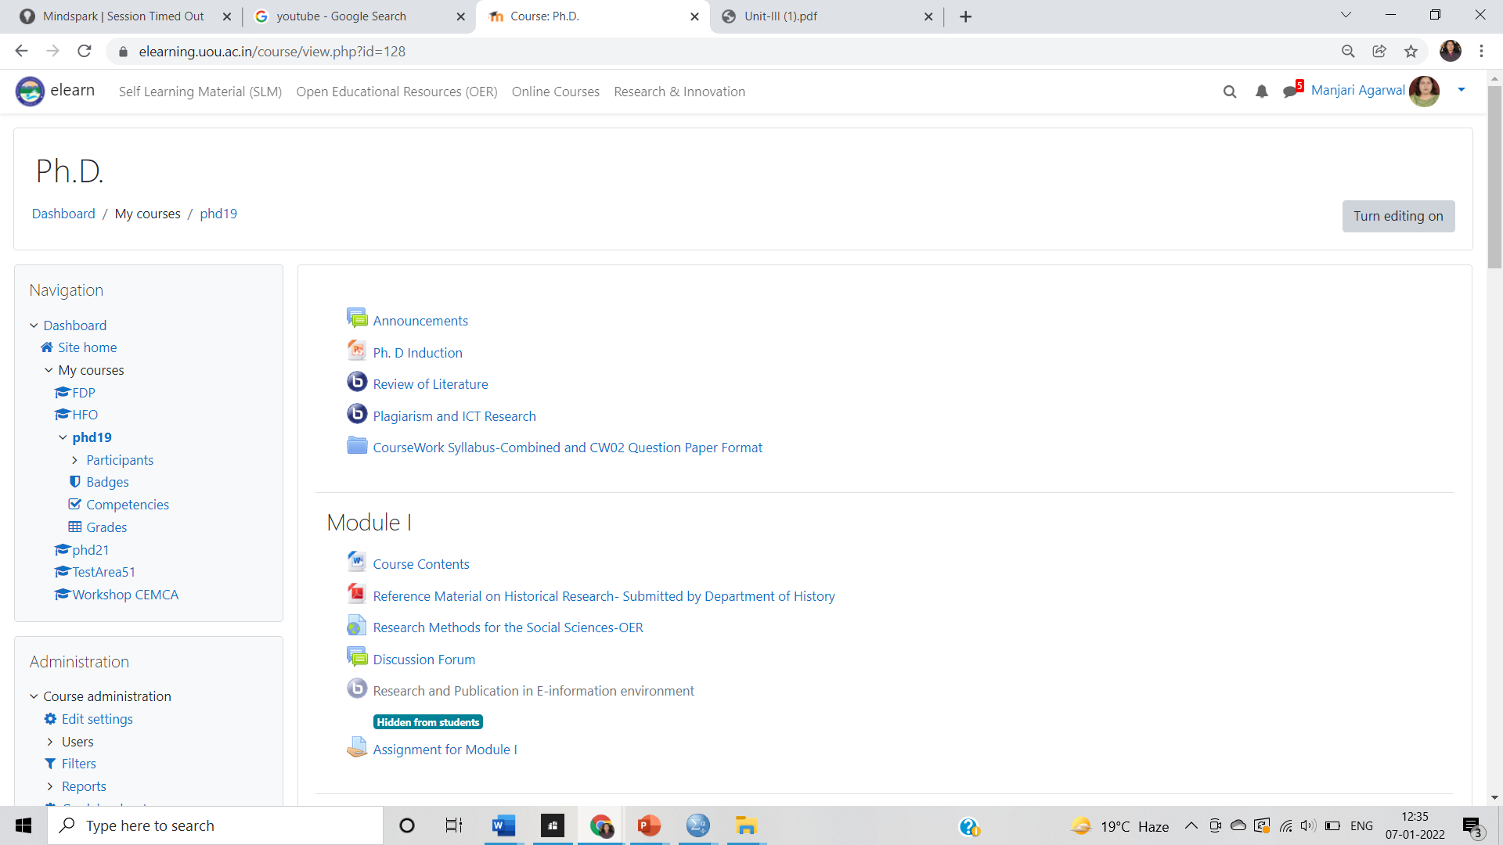
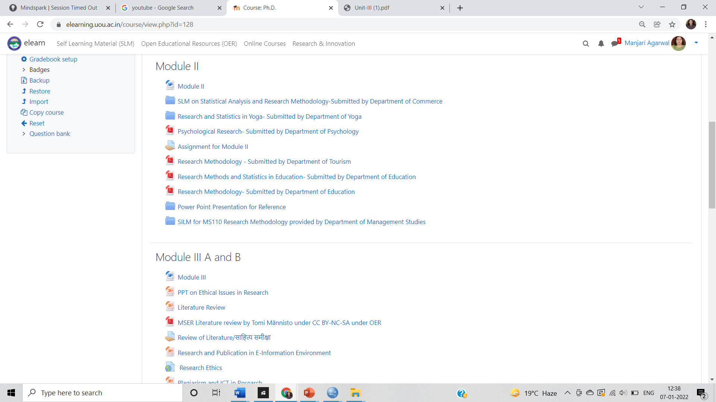
Screen Shots of LMS
https://elearning.uou.ac.in/

Slide 27
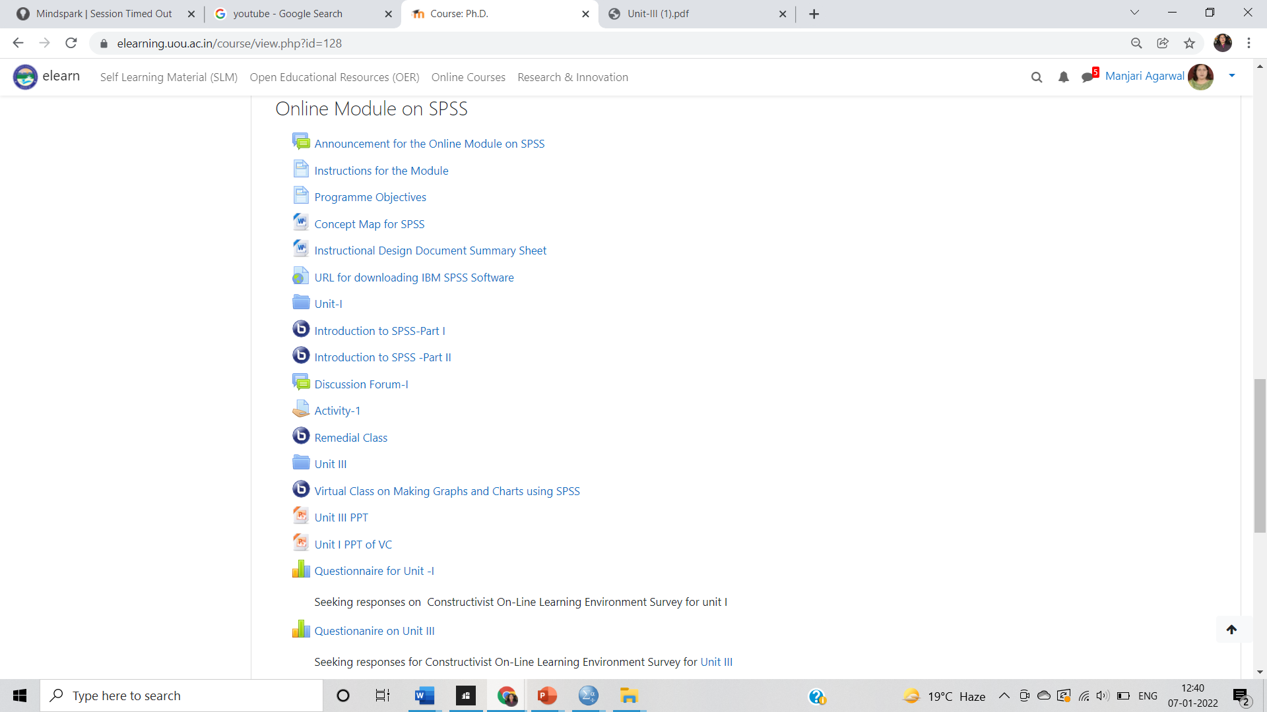
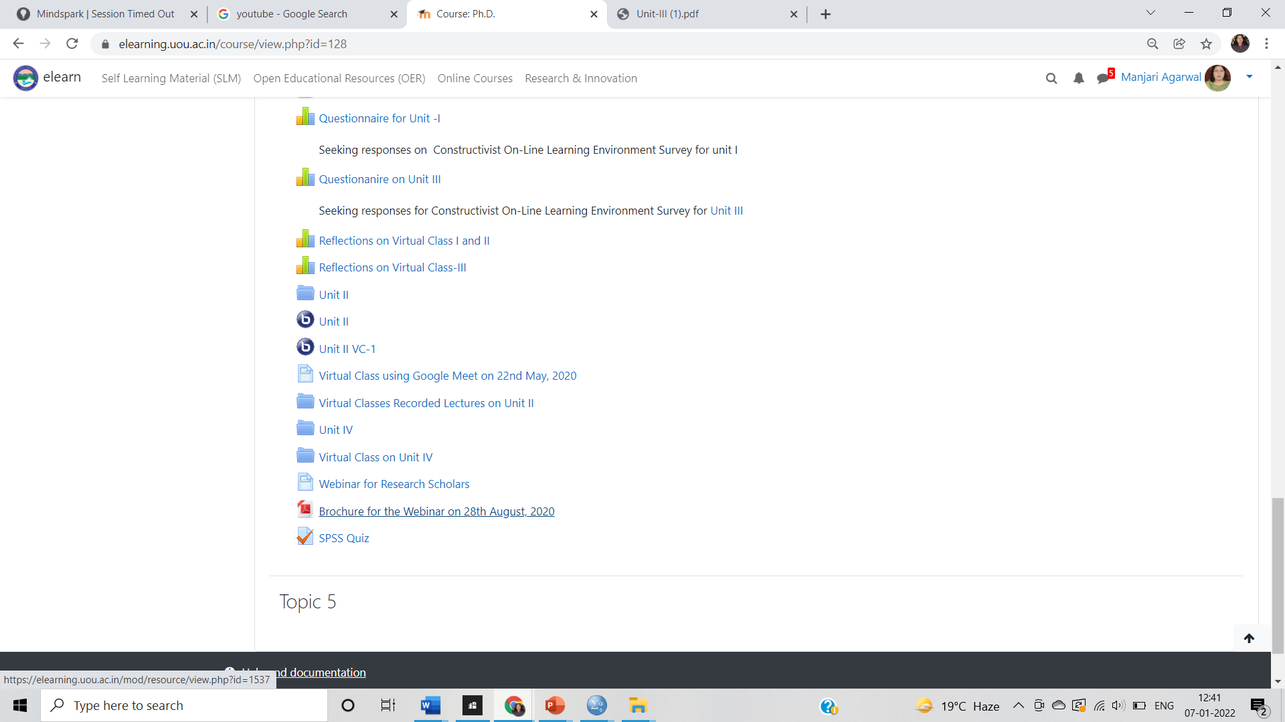
Online Course on SPSS
(SPOC offered through UOU’s LMS) For 2019 batch

Slide 28
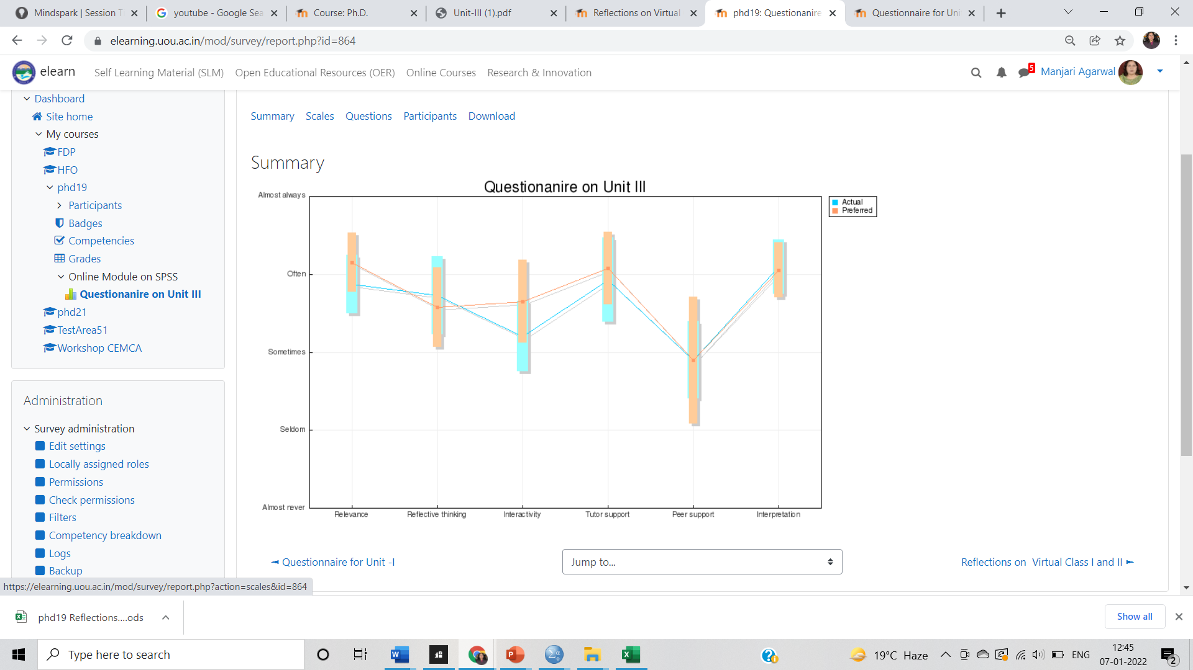
Student Feedback on Online Course on SPSS

Slide 29
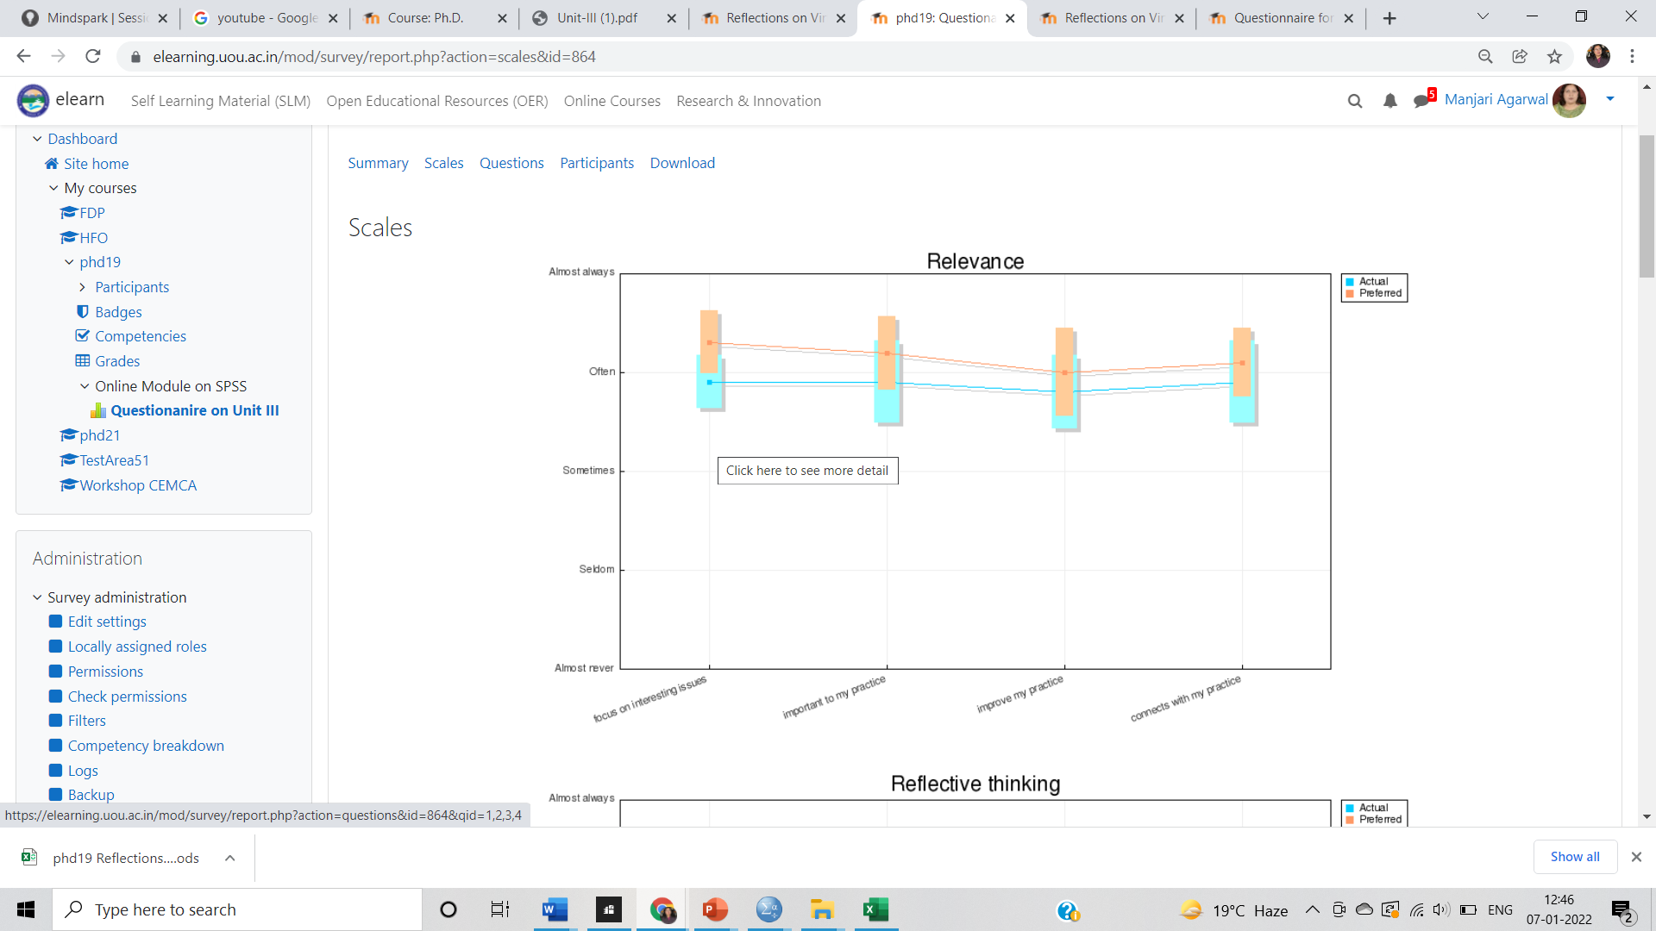

Slide 30
Year wise Total number of Ph.D Scholars
Year | Number of Scholars
2012-13 | 16
2013-14 | 10
2019-20 | 25
2020-21 | 31
2022-23 | 36
2023-24 | 39

Slide 31
Total Awarded Ph.D Scholars
YEAR | NO. OF AWARDED PH.D SCHOLARS | AWARDED IN CONVOCATION
2018 | 07 | 4th
2019 | 11 | 5th
2021 | 01 | 6th
2022 | 01 | 7th
2023 | 05 | 8th
2024 | 08 | At Upcoming Convocation
TOTAL | 33
https://uou.ac.in/downloads/phd-awarded-22.pdf
Notes:
Add Hyperlink

Slide 32
Initiatives
Integration of Learning Management System in Ph.D. Coursework for dissemination of contents and information.
Inclusion of Small Private Online Course (SPOC) on SPSS.
Indian Traditional Knowledge pertaining to research blended with the latest technologies.
Well defined Transcript for Coursework.
To ensure high quality original research, the Directorate emphasizes upon a Module on Research and Publication Ethics in course work.
UGC-INFLIBNET Plagiarism software is also provided to the Faculty and research scholars for Plagiarism Checking.
https://uou.ac.in/sites/default/files/2021-10/urkund.pdf

Slide 33
SWOC Analysis of Directorate of Research and Innovation
INTERNAL
STRENGTHS
WEAKNESSES
Multidisciplinary and Interdisciplinary Perspective
Experts from different Universities and Institutions provides insights to our Learners
Inclusion of Traditional knowledge and Indian Wisdom in Coursework
Technology enabled Learning-LMS,MOOCs and SPOC
Outreach-Enrolment of learners from all across the state
Economical Fee Structure
Broadly following NEP
Daily Lecture Reports
Non enrolment of JRFs
Research Outcomes are not referred in policy making
Lack of Start Ups
Don’t publish a Research Journal
Paucity of sponsorship from CSR funds for research activities
No much collaborative research projects among faculty members.
Weak ties with Industry
Graduate and post Graduates are not much research oriented
OPPORTUNITIES
Challenges
Consultancy to Government Bodies
Ties up with IIT, IIM and other renowned organisations
Sharing of Modules with other Universities
Implementation of research oriented programmes in Fourth Year of graduation s per NEP
Proximity of Industrial park near University
International Tie-ups
Expanding on the research activities on being
more socially responsible
Mindset of society in general regarding acceptance of ODL University imparting face to face research degree programme
Fetching of Sponsorship/ research Grants- Not sill under UGC 12B
EXTERNAL

Slide 34
Inclusion of NEP
Nurturing responsible learners with social commitments.
Learnability across disciplines to have broader insights.
Holistic and multidisciplinary perspective
Inclusion of Ethics and Human values
Critical thinking, effective communication and responsible leadershi
Leveraging the advantages of technology
Promoting Scientific Temper

Slide 35
Future Planning
Collaborative Research Projects
Seeking Funds from SIDCUL for research activities from their CSR Funds
Rendering Consultancy services to other organisations
SILM/ e-content development for Courses
Fostering Inter and Intra Department Research Activities
MOUs with reputed research organisations
Establishment of Incubation centre for StartUps

Slide 36
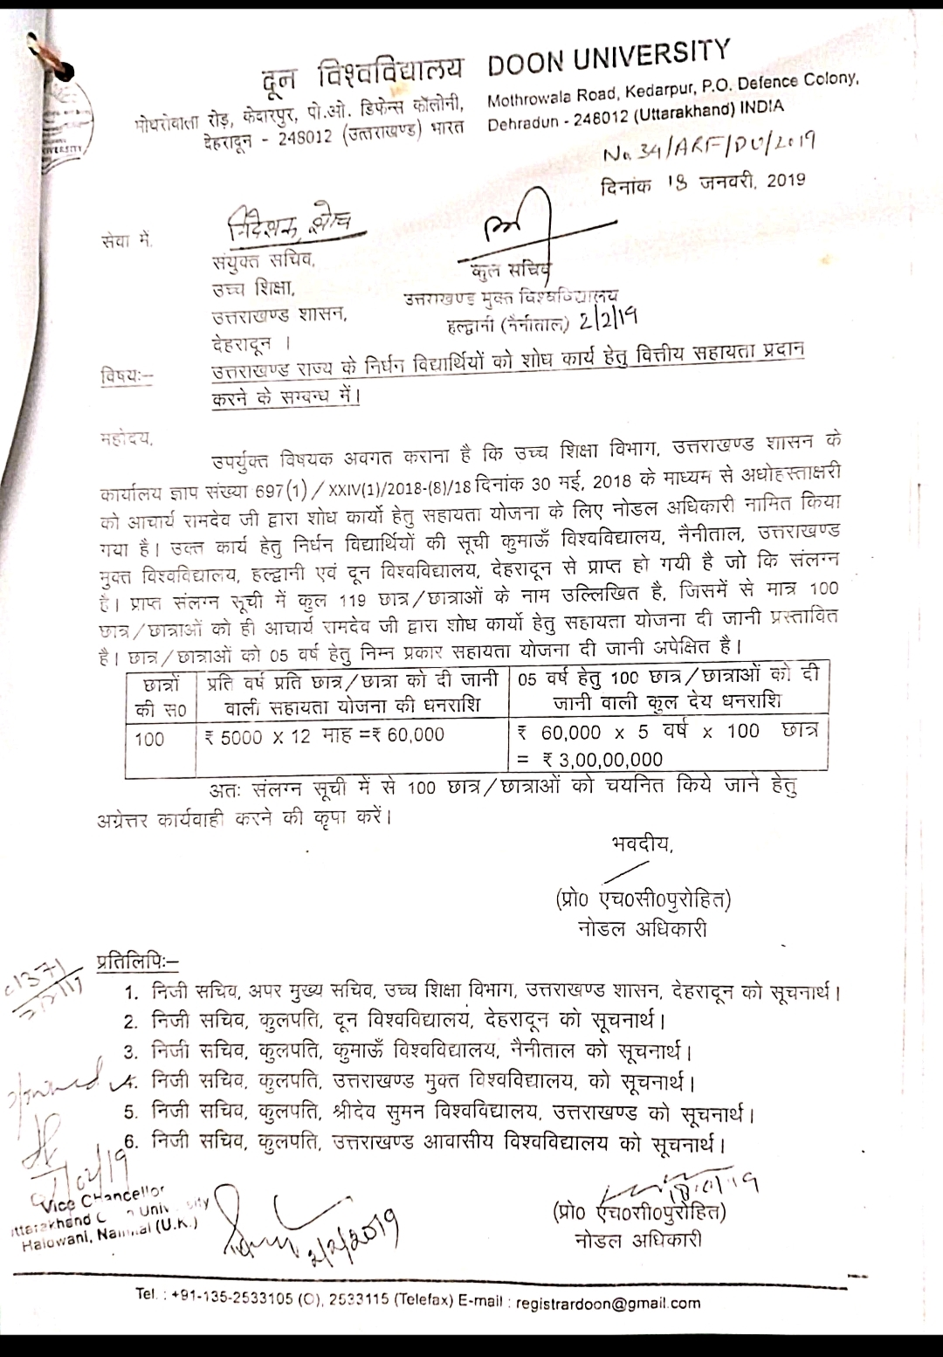
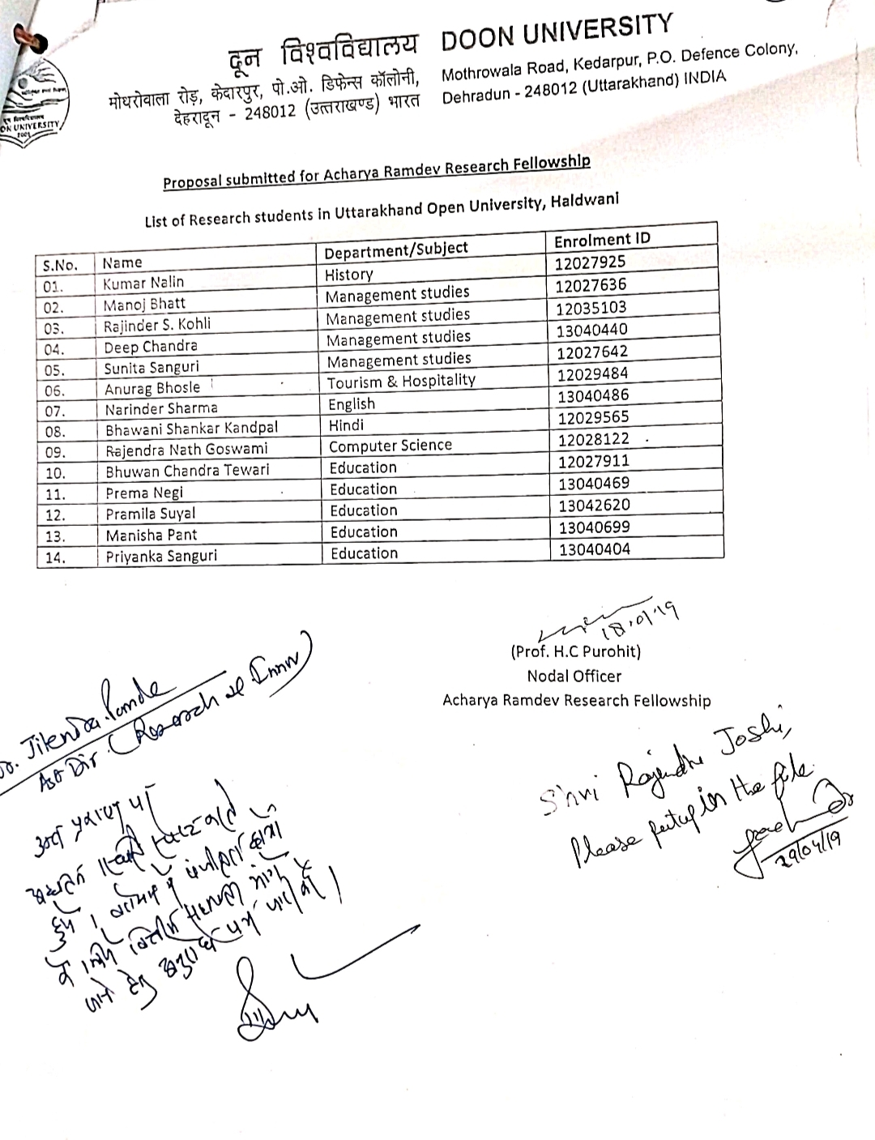
Achievements
Financial assistance is provided by “Acharya Ramdev” to the poor students of UOU for their research work.

Slide 37
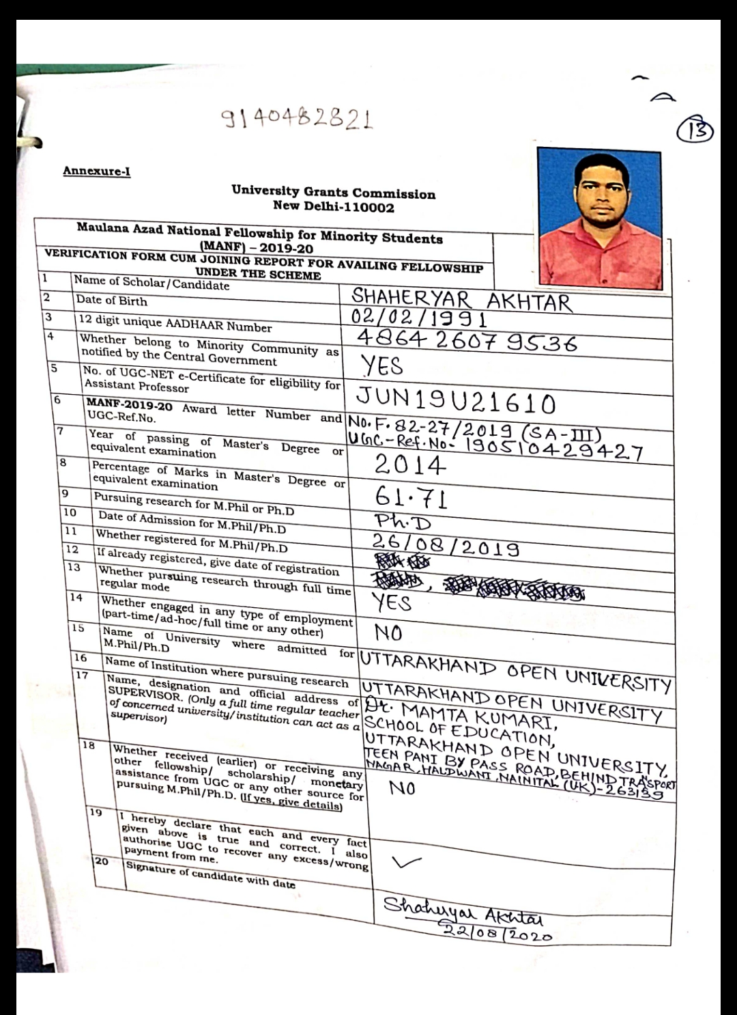
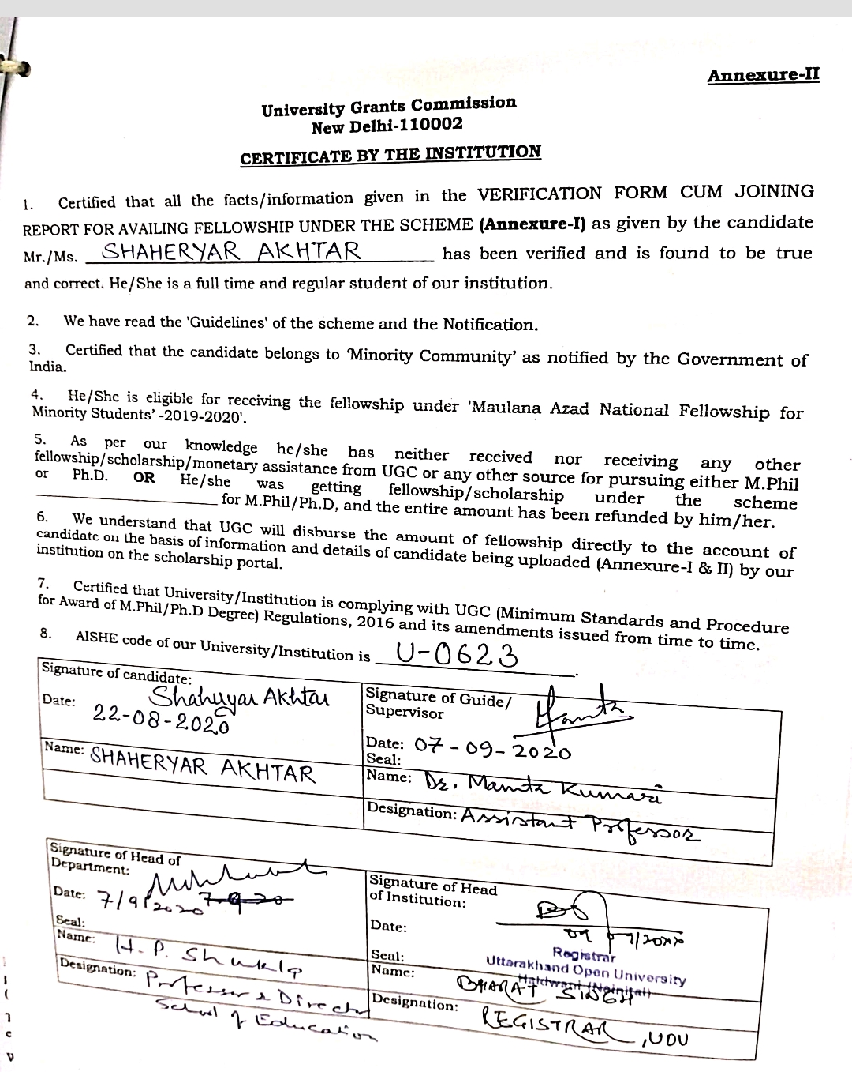
One Candidate who has been awarded Maulana Azad National Fellowship.
Notes:
Also one

Slide 38
JRF AND NFSC Scholarship
06 Research Scholars of the University awarded the fellowship (JRF and NFSC) provided by UGC.
Name of Scholar | Enrollment No. | Fellowship
Mr. Rakesh Joshi | 24337995 | JRF
Mr. Sandeep Tomar | 12028102 | JRF
Ms. Shahi Siddiqui | 20237798 | JRF
Mr. Ashugeet Mukul | 23304535 | NFSC
Ms. Bhawana Rajput | 23304450 | NFSC
Ms. Reema | 23304328 | NFSC

Slide 39
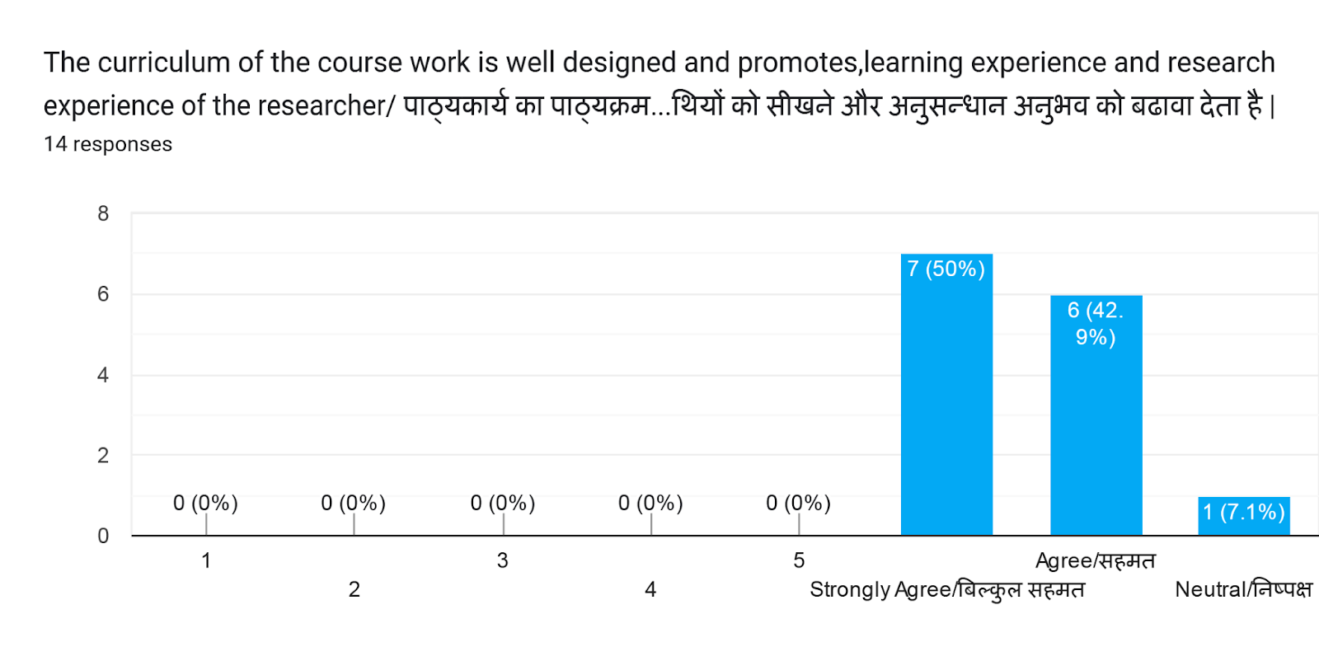
Feedback of Research Scholars about their Pre-Ph.D Course Work
Feedback from Research scholars enrolled in Ph.D -2021-22
The curriculum of the course work is well designed and promotes, learning experience and research experience of the researcher/ पाठ्यकार्य का पाठ्यक्रम अच्छी तरह से तैयार किया गया है और शोधार्थियों को सीखने और अनुसन्धान अनुभव को बढावा देता है |

Slide 40
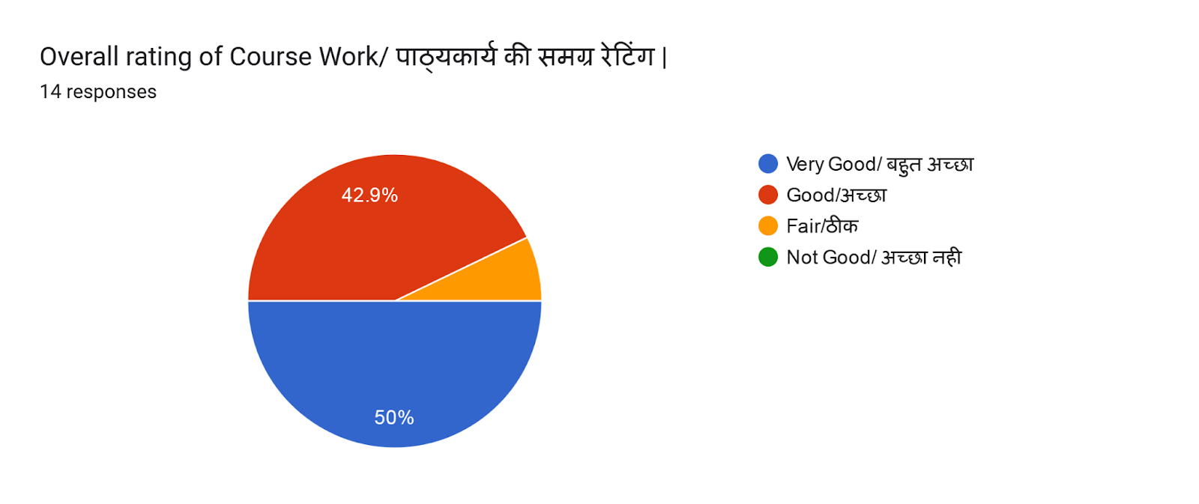
Link - https://forms.gle/mYDYi3zWueVxWgms5

Slide 41
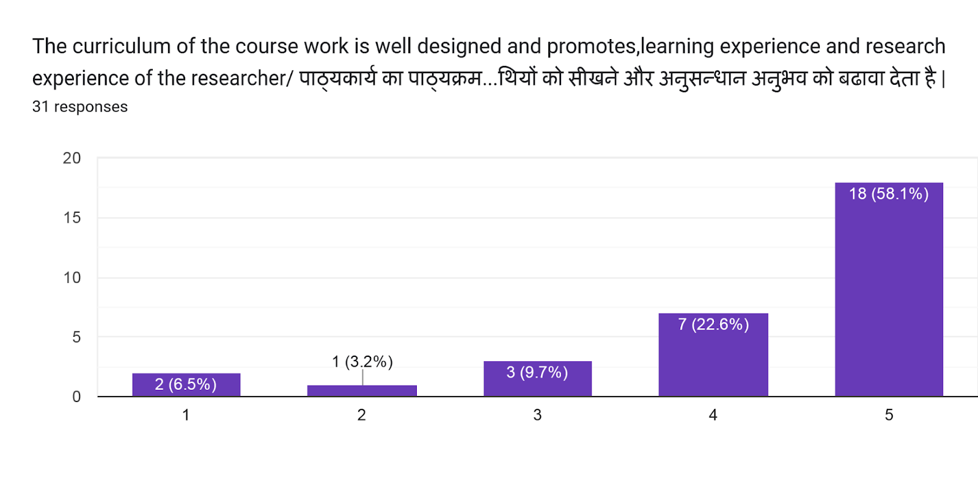
Feedback from research scholar enrolled in Ph.D – 2022-23
The curriculum of the course work is well designed and promotes, learning experience and research experience of the researcher/ पाठ्यकार्य का पाठ्यक्रम अच्छी तरह से तैयार किया गया है और शोधार्थियों को सीखने और अनुसन्धान अनुभव को बढावा देता है |
Strongly disagree Disagree Neutral Agree Strongly Agree
Notes:
Strongly disagree

Slide 42
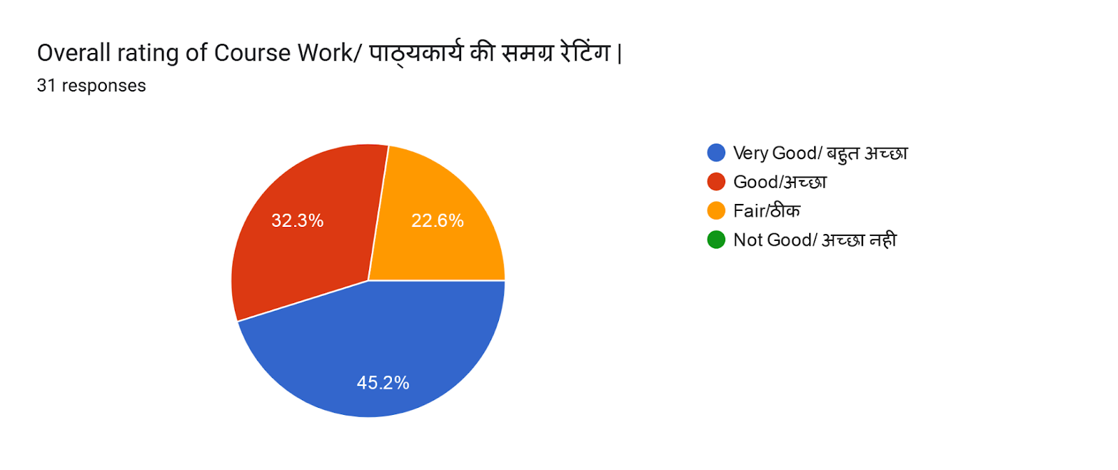
Overall Rating of the Course Work.
Link : https://forms.gle/JZWFQR8aHomC6o2z6
Notes:
Link

Slide 43
Distinguish Alumni(Ph.D Scholars)
Name of Ph.D Scholars | working in present
Dr. Mamta Kumari | Assistant Professor (Edu)in UOU
Dr. Bhuwan Chandra Tiwari | Lecturer in Govt of Delhi
Dr. Uma Pandey | Assistant Professor(Edu)
Dr. Lt. Col. Rajendra Singh Kohli(Ret) | Indian Army
Dr. Manisha Pant | Assistant Professor in UOU
Dr.Dinesh Kandpal | Assistant Professor in UOU
Dr. Vipin Chandra | Journalist in Zee TV

Slide 44
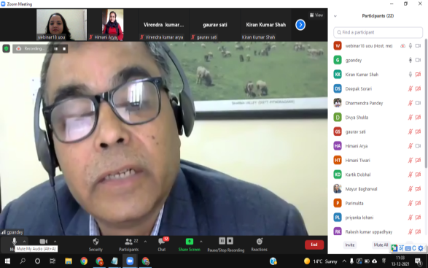
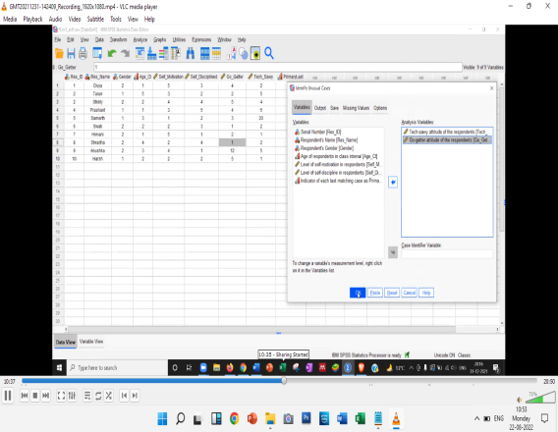
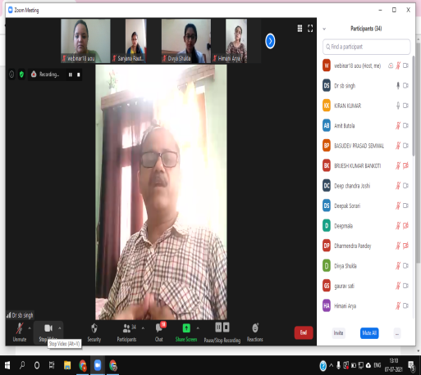
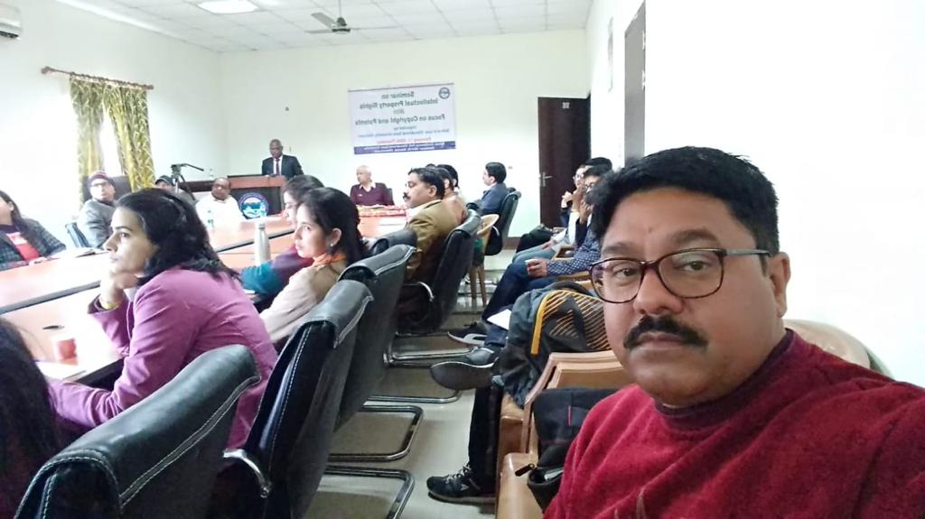
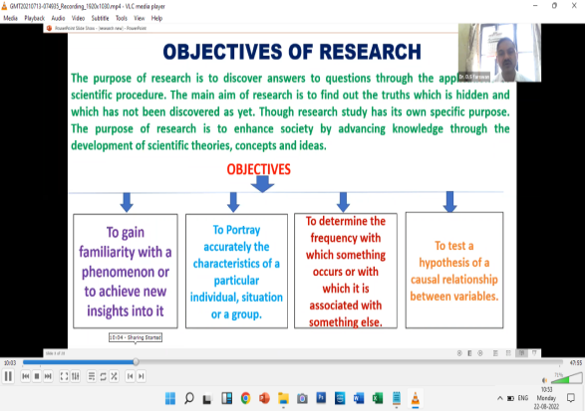
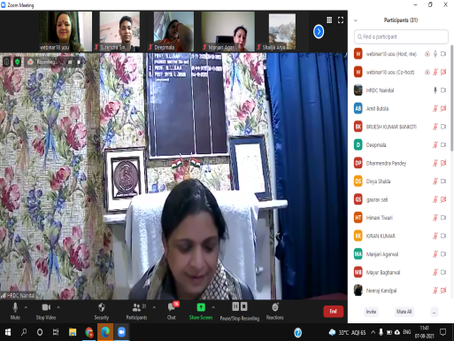
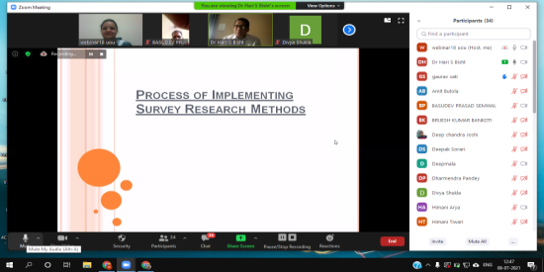
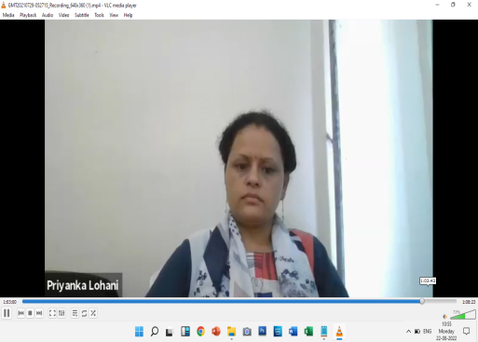
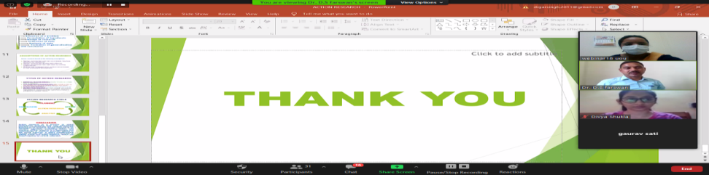
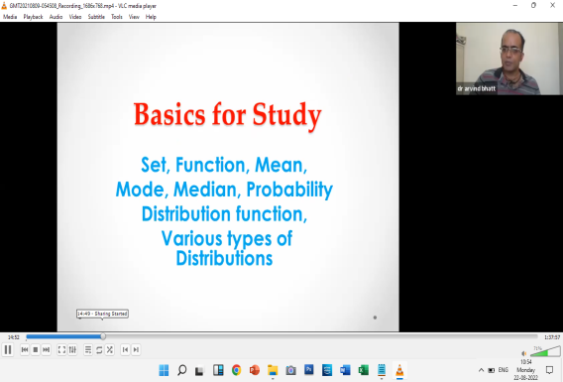
Glimpses of the Coursework
Workshops
Class Activities
Online Classes
Hands-on Sessions
Lectures
Lecture By Dr. Manjari Agarwal

Slide 45
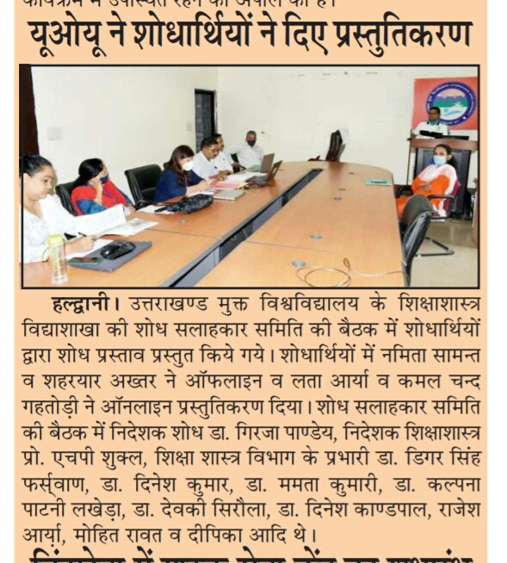
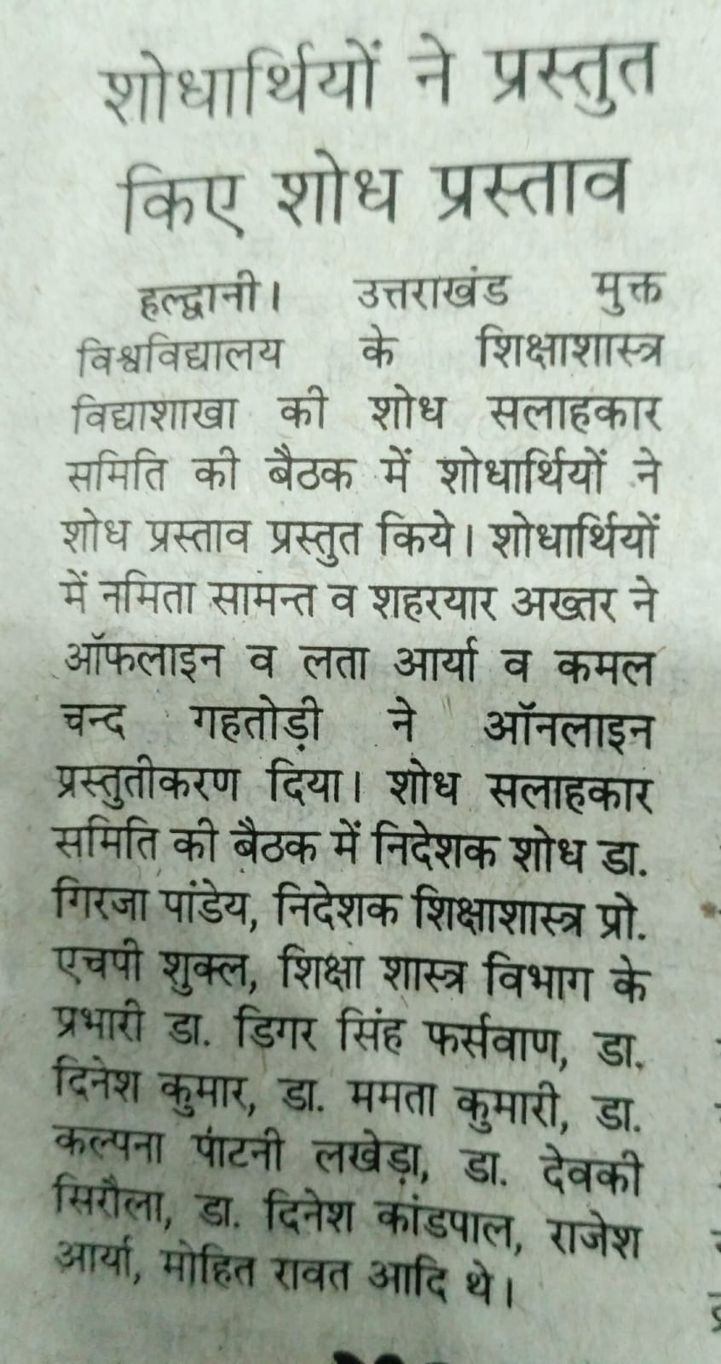
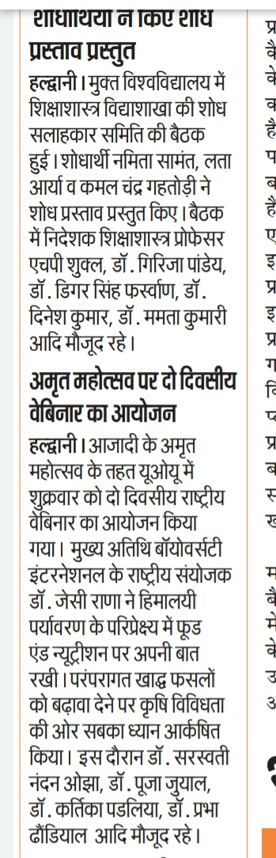
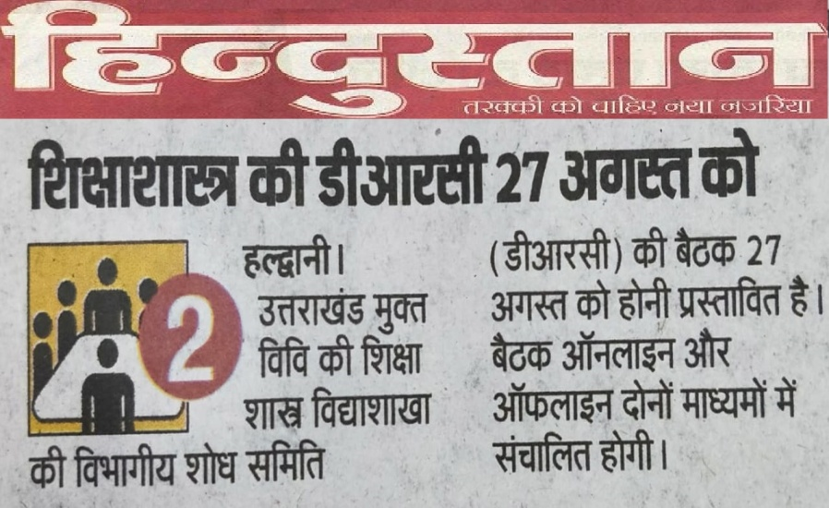
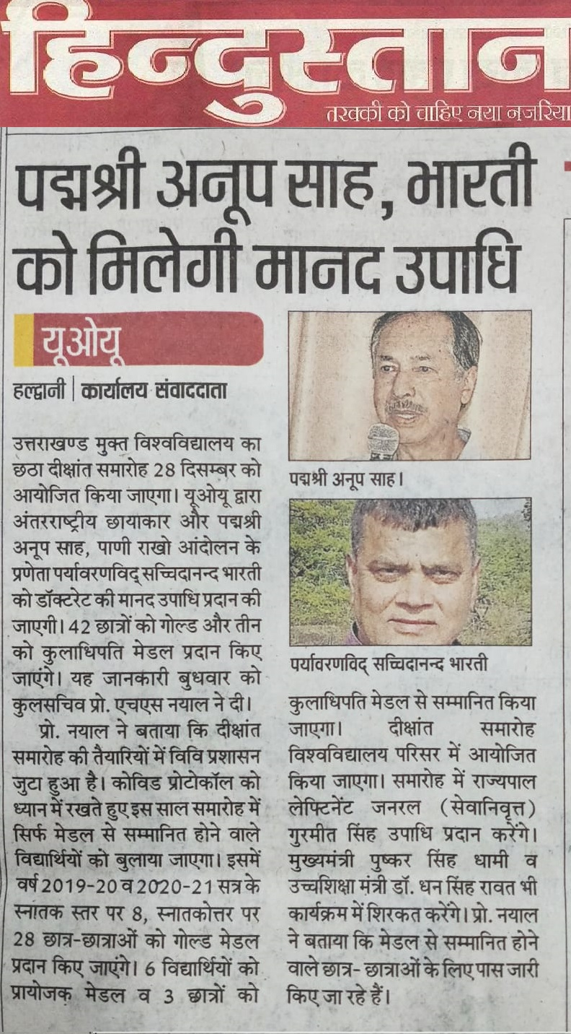
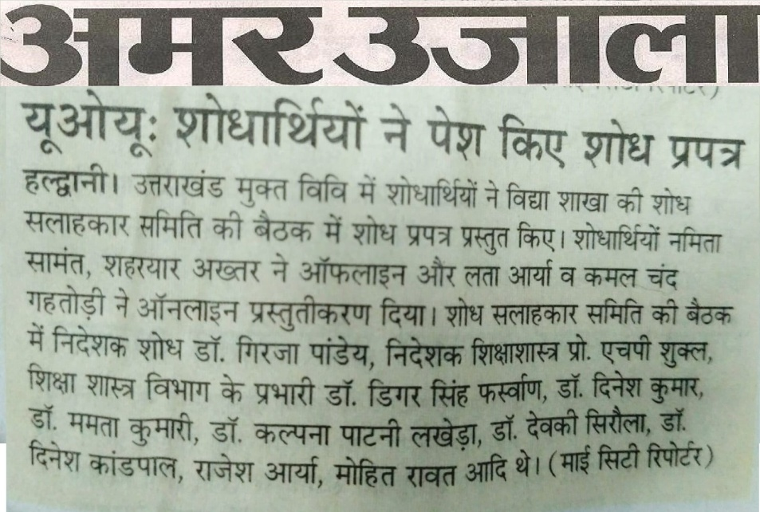
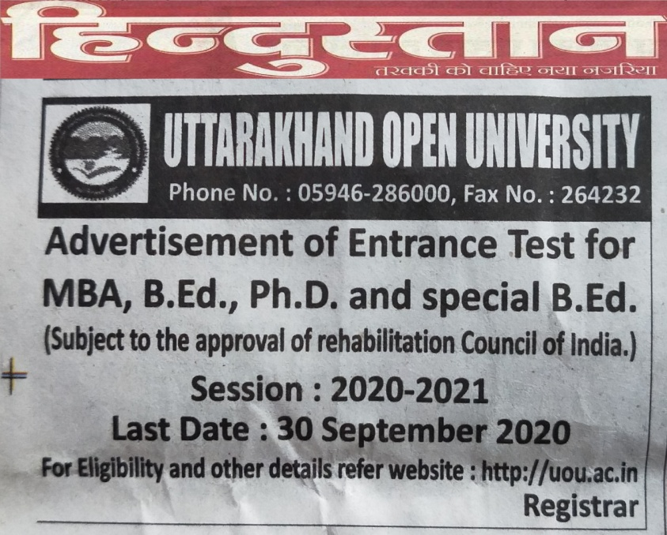
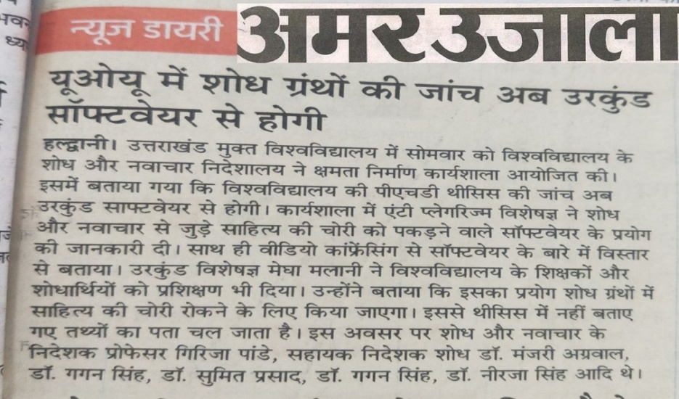
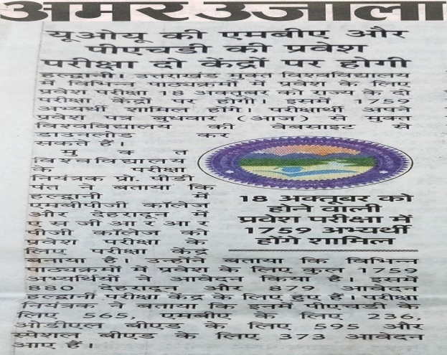
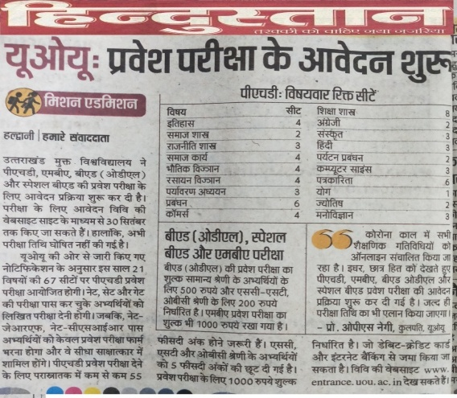
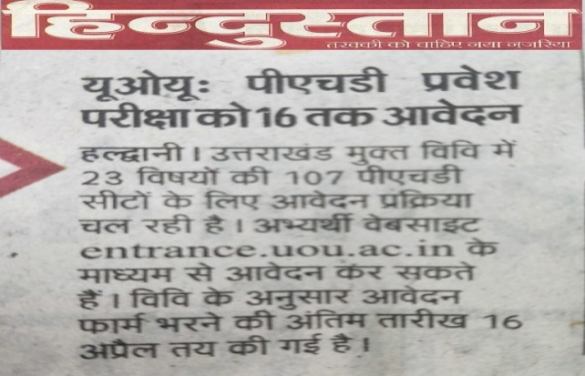
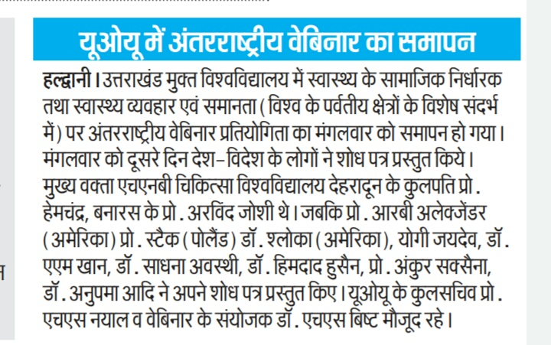
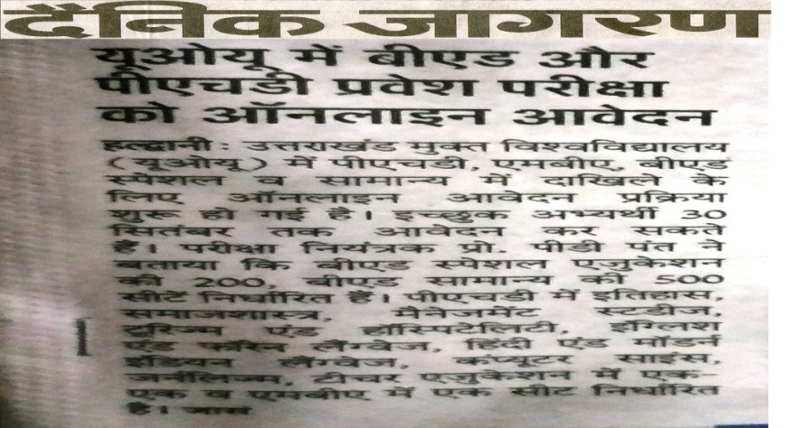
Newspaper Highlights

Slide 46


